Slide 1

U-CARE
The University Care
Group - 01

Slide 2
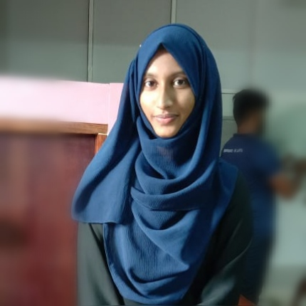
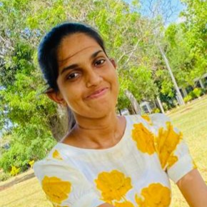
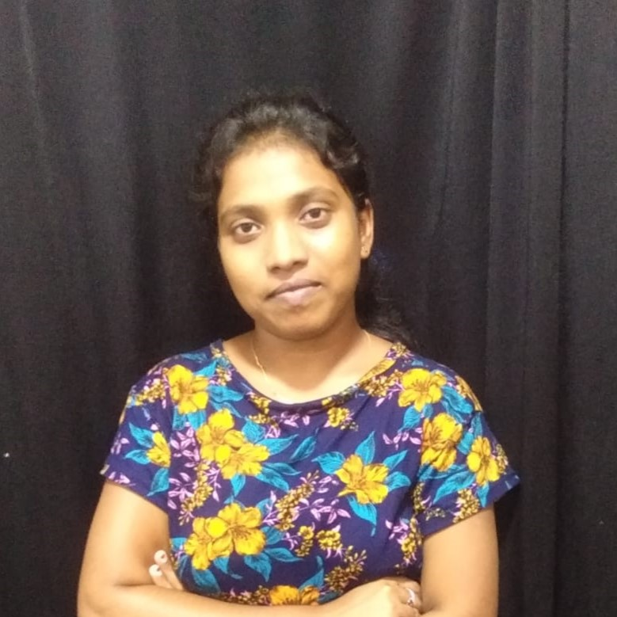
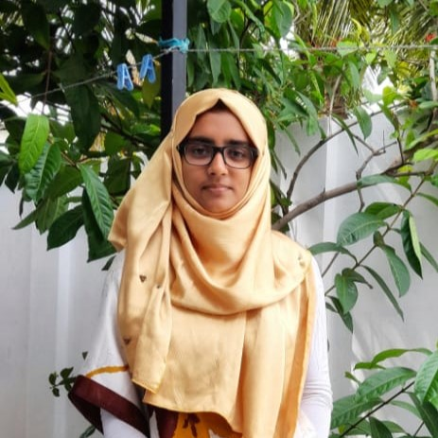
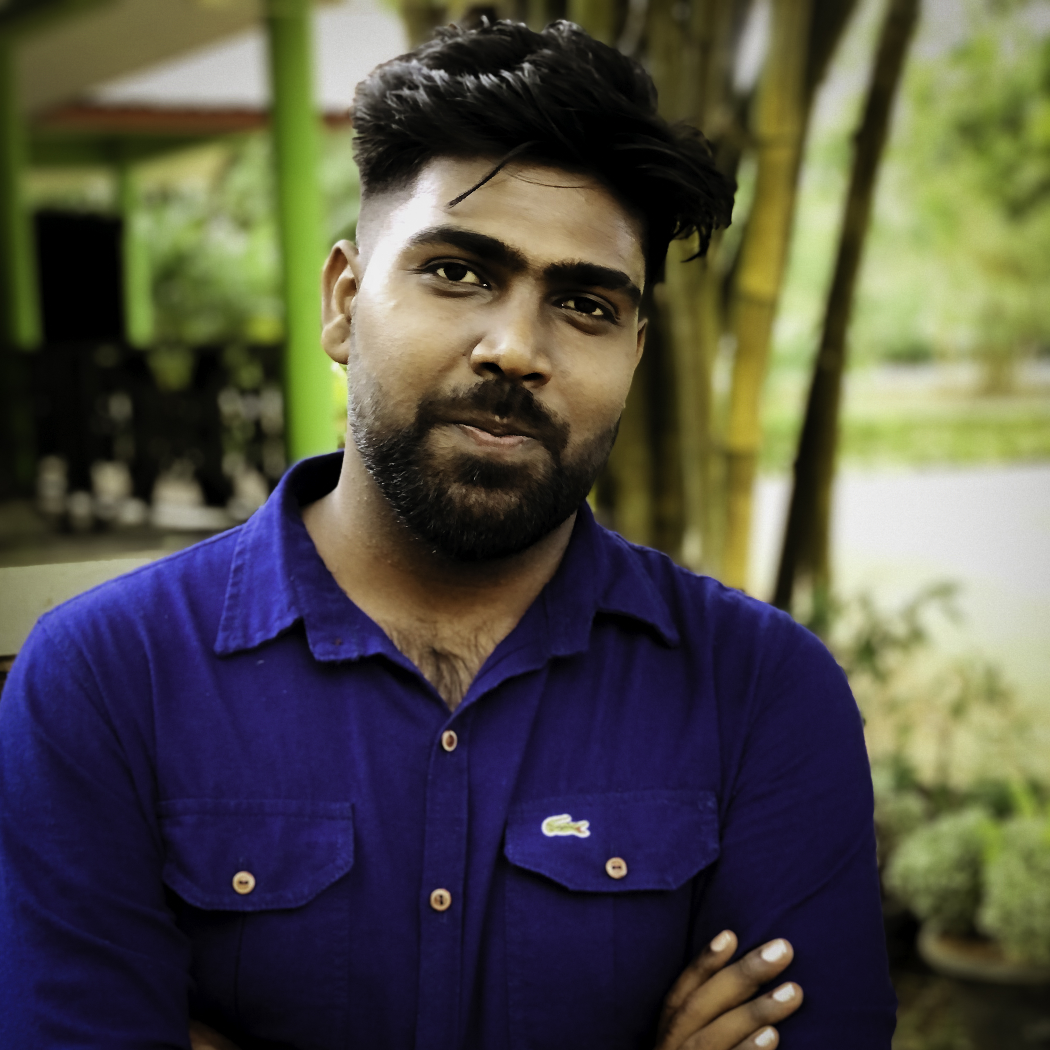

THE TEAM
2017/ICT/17
2017/ICT/44
2017/ICT/53
2017/ICT/58
2017/ICT/74
2017/ICT/86

Slide 3
Complaint Management System for University Students.
Introduction
2017/ICT/53

Slide 4
BACKGROUND
2017/ICT/53
Students feel a fear to tell their statements against high level staffs and unable to go to the related committee to explain those problems in the available manual system.

Slide 5
RELATED SYSTEMS

Slide 6
Complaint System of Peradeniya University
Identities of those who file a complaint are strictly protected.
Identify the mental state of the person who has come to lodge a complaint.
Personal email of the complainer will be revealed.
2017/ICT/58
Find the portal by : https://www.pdn.ac.lk/omplaints/complaints.php
System has only one type for
all the Complaints.

Slide 7
Pakistan Citizen Portal
Designed to help the Government Organizations to efficiently respond to the matters raised on the Portal.
Highly unprofessional and Irresponsible behavior.
Having Sign in issue.
2017/ICT/58
To provide citizens' an opportunity to seamlessly communicate with all government entities and have their issues resolved with priority.
Option to dropped complaints too with
attachment option.

Slide 8
Jansunwai
A unique user name and password are given to the applicant.
There is no manual process.
Officers can also update the report after complaining about the report.
2017/ICT/58
This portal is to help and hear the problems of the residents of uttar pradesh.
Name of the applicant, Email ID of the applicant , Mobile number of the applicant can be seen by the admin.
Matters related to Right to Information are not accepted.
Makes the complaint confidential
Give the facilities to people to register grievances at any time from any place.
Suggestion are not accepted

Slide 9
Foreign Minister Portal
User-friendly Interface.
Resolves complaints and concerns.
Welcome feedback.
2017/ICT/86
A complaint management system which helps in resolving queries and concerns of overseas pakistanis and foreign nationals living abroad.
Size of attachment while register a
complaint is very low.
Number of attachments while register a complaint is less than 3.

Slide 10
National Consumer Helpline
Consumer awareness material under the link Consumer Knowledge Base.
Addresses of Various Consumer are also available under the link consumer Forum Contact Details.
Various useful sites are linked under important Links.
2017/ICT/86
This mobile app is an alternate way to register consumer related grievances in the portal
Contents of links to sites outside this web portal are not the responsibility of the Department.

Slide 11
WAFAQI MOHTASIB CMIS
The status of your case show at each stage.
Receive SMS within minutes of lodging a complaint which will confirm the registration of complaint.
Connects general public Secretariat and allows them to lodge their Complaints.
2017/ICT/86
App allows to lodge their complaints against pak. Federal government agencies.
The app hotline assistance is not working for 24 X 7.
The email which used for file a complaint will be revealed.

Slide 12
METHODOLOGY

Slide 13
SPIRAL MODEL
2017/ICT/74
Planning
Design & Implementation
Requirements
Gathering
Deployment
Evaluation
Testing

Slide 14
METHODOLOGY
DESIGN & IMPLEMENTATION PHASE
PLANNING PHASE
REQUIREMENT GATHERING PHASE
2017/ICT/74
ER Diagram:Draw.io
Wire Frame:AdobeXD
XAMPP:MYSQL
VS Code:PHP
HTML
CSS
Bootstrap
JavaScript
Divide
Allocate
Schedule
Gantt Chart
Observation
Interview
Brain Storming
Survey

Slide 15
METHODOLOGY
EVALUATION PHASE
DEPLOYMENT PHASE
TESTING PHASE
2017/ICT/74
Enhancement
Versions
Delivery
Feedbacks
Updates
Unit Testing
Integration Testing
System Testing
Acceptance Testing

Slide 16
DESIGN AND IMPLEMENTATION
HEADER
TEXT
SLIDER
ICONS

Slide 17
USE CASE DIAGRAM
2017/ICT/17

Slide 18
SOFTWARE ARCHITECTURE
Application
Database
Web Client (Browser)
2017/ICT/17
Three-tier Architecture

Slide 19
IMPLEMENTATION

Slide 20
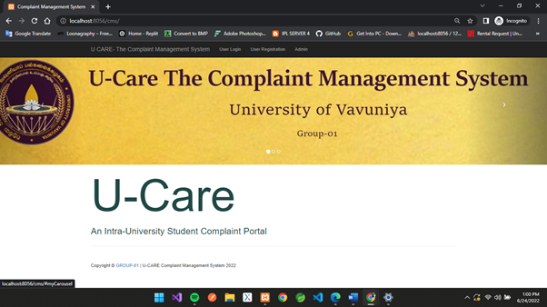
INDEX PAGE 1
2017/ICT/17

Slide 21
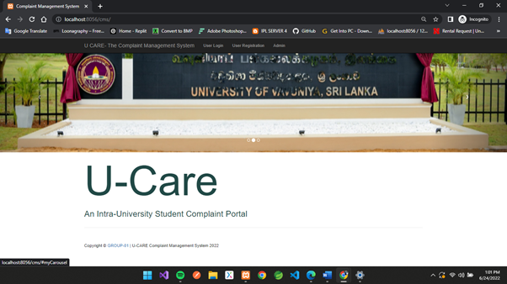
INDEX PAGE 2
2017/ICT/17

Slide 22
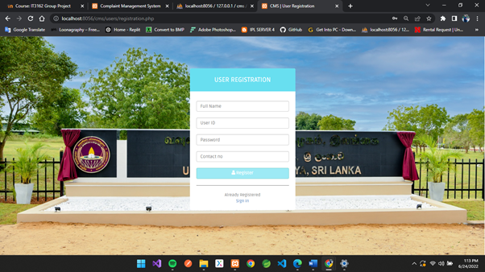
USER REGISTRATION PAGE
2017/ICT/17

Slide 23

USER SIGN IN PAGE
2017/ICT/17

Slide 24
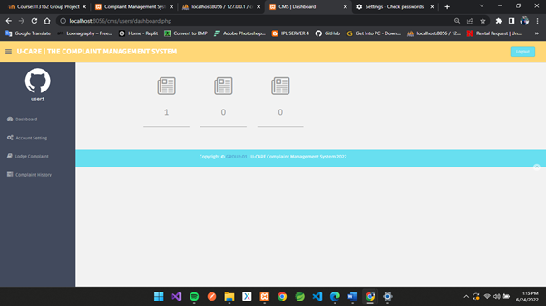
DASHBOARD (USER)
2017/ICT/17

Slide 25
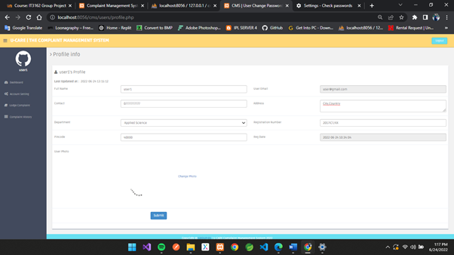
ACCOUNT SETTING (USER)
2017/ICT/17

Slide 26
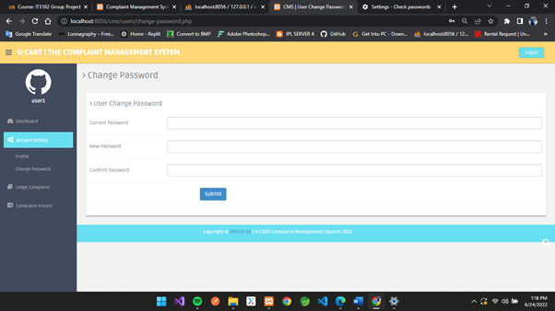
CHANGE PASSWORD (USER)
2017/ICT/17

Slide 27
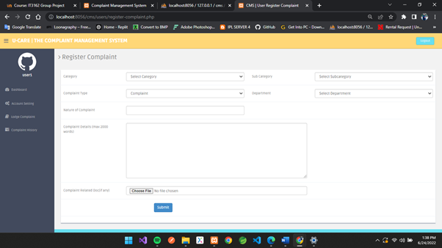
LODGE COMPLAINT (USER)
2017/ICT/17

Slide 28
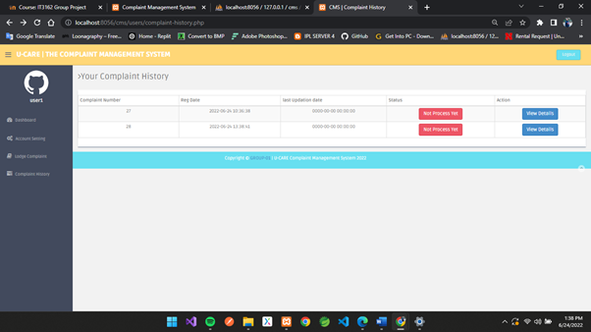
COMPLAINT HISTORY
2017/ICT/17

Slide 29
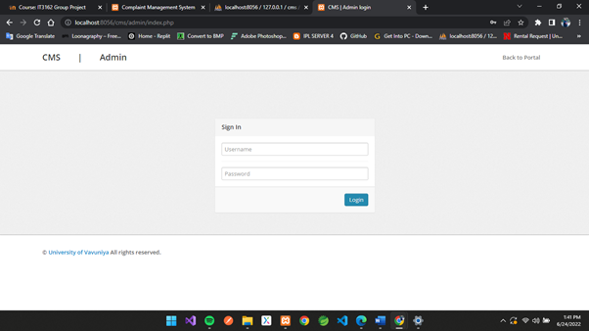
ADMIN LOGIN PAGE
2017/ICT/17

Slide 30
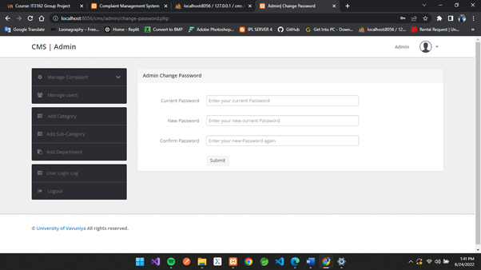
CHANGE PASSWORD (ADMIN)
2017/ICT/17

Slide 31
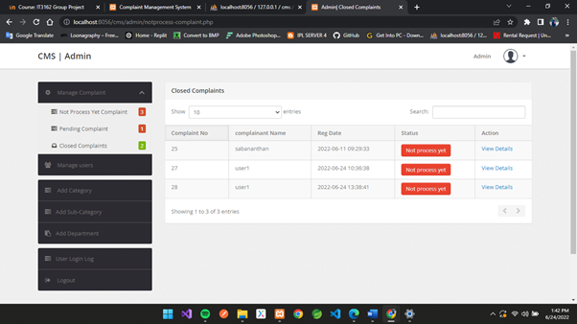
MANAGE COMPLAINTS (ADMIN)
2017/ICT/17

Slide 32
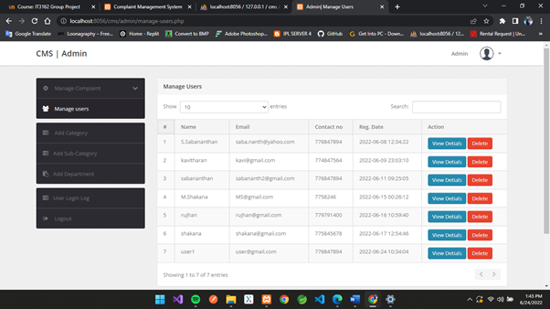
MANAGE USERS (ADMIN)
2017/ICT/17

Slide 33
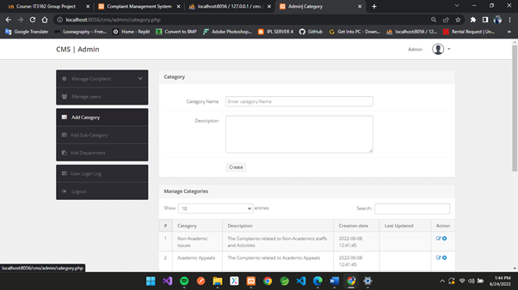
ADD CATEGORY (ADMIN)
2017/ICT/17

Slide 34
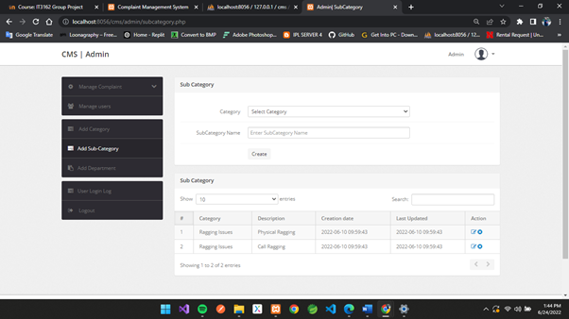
ADD SUB CATEGORY (ADMIN)
2017/ICT/17

Slide 35
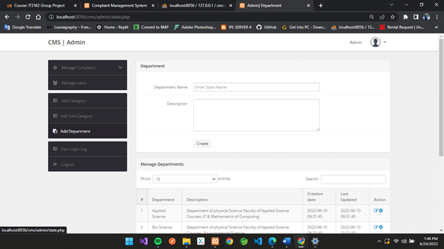
ADD DEPARTMENT (ADMIN)
2017/ICT/17

Slide 36
CHALLANGES WE FACED
01
03
Time constraints
Skills management
02
04
Motivating team members
Communication Problems
2017/ICT/44

Slide 37
FUTURE IDEAS
2017/ICT/44
web application into mobile app. This will reach very efficiently among the users.
update the features more interactive
with the users.
Any complain is needed to solve by the UGC, can implement the app by give an admin to the UGC and they can monitor the complaints.
Provide the portal to not only other universities also other private sectors
and organizations.
.

Slide 38
REFERENCES
2017/ICT/44
https://www.modishproject.com/students-complaints-management-system/.
Dec 21 2021
https://www.waterintegritynetwork.net/2015/12/03/customer-complaint.
Dec 29 2021
https://www.waterintegritynetwork.net/2015/12/03/customer-complaint-managementmanagement/.
Jan 01 2022
https://policy.usq.edu.au/documents/141630PL/.
Feb 14 2022

Slide 39
THANKS ! & STAY SAFE.
Does anyone have any question?

